Slide 1
BITS Pilani presentation
Mridul Moitra
Cloud Computing

Slide 2
<CSI ZG527 / SS ZG527 / SE ZG527
Cloud Computing- Docker Technology
Lecture No. 5

Slide 3
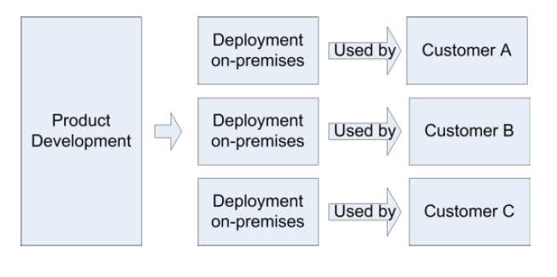
Traditional Deployment Model
Notes:
http://www.rightscale.com/blog/enterprise-cloud-strategies/four-steps-achieving-high-availability-cloud

Slide 4
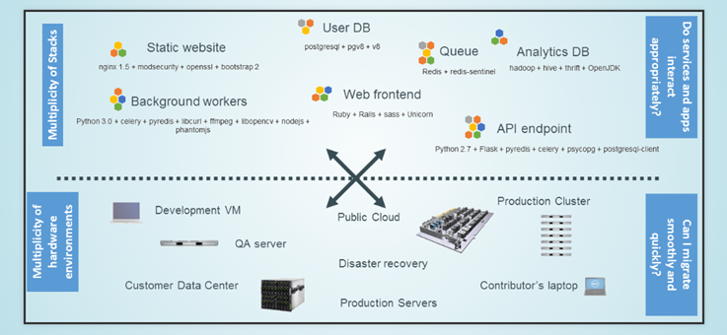
Challenges

Slide 5
Introduction
Linux containers (LXC) are “lightweight” VMs
Docker is a commoditized LXC technique that dramatically simplifies the use of LXC

Slide 6
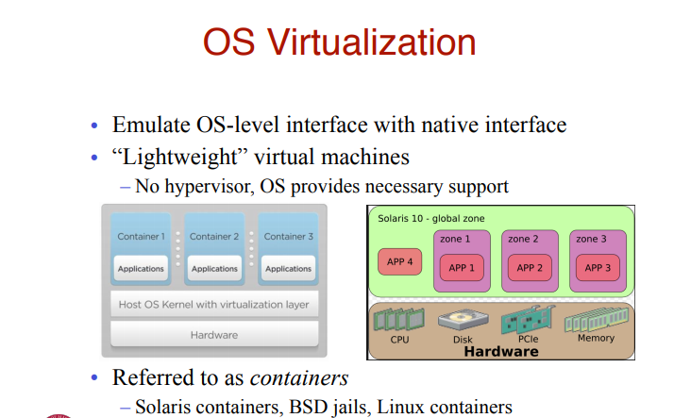
OS Virtualization

Slide 7
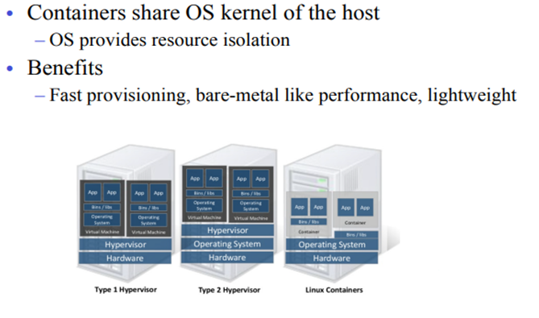
Linux Container

Slide 8
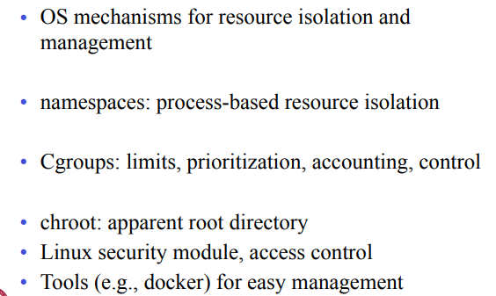
OS Mechanisms for LXC

Slide 9
Linux Namespaces
Linux kernel provides the “control groups” (cgroups) functionality
allows limitation and prioritization of resources (CPU, memory, block I/O, network, etc.) without the need for starting any VM
“namespace isolation” functionality
allows complete isolation of an applications' view of the operating environment, including process trees, networking, user IDs and mounted file systems

Slide 10
Container Features
Containers running in the user space
Each container has
Own process space
Own network interface
Own /sbin/init (coordinates the rest of the boot process and configures the environment for the user)
Run stuff as root
Share kernel with the host
No device emulation

Slide 11
Isolation with cgroups
Memory
Cpu
Blkio
devices

Slide 12
Memory cgroup
keeps track pages used by each group:
file (read/write/mmap from block devices; swap)
anonymous (stack, heap, anonymous mmap)
active (recently accessed)
inactive (candidate for eviction)
each page is charged to a group
pages can be shared
Individual (per-cgroup) limits and out-of-memory killer

Slide 13
CPU cgroup
keep track of user/system CPU time
set relative weight per group
pin groups to specific CPU(s)
Can be used to reserve CPUs for some apps

Slide 14
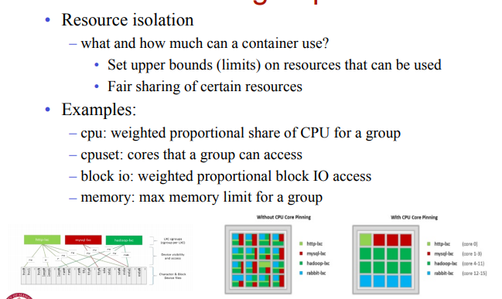
Linux CGGROUPS

Slide 15
Blkio cgroup
keep track IOs for each block device
read vs write; sync vs async
set relative weights
set throttle (limits) for each block device
read vs write; bytes/sec vs operations/sec

Slide 16
Devices cgroup
controls read/write/mknod permissions
typically:
allow: /dev/{tty,zero,random,null}...
deny: everything else
maybe: /dev/net/tun, /dev/fuse, /dev/kvm, /dev/dri...
fine-grained control for GPU, virtualization, etc

Slide 17
Almost no overhead
Processes are isolated, but run straight on the host
CPU performance = native performance
Memory performance = a few % shaved off for (optional) accounting
Network performance = small overhead; can be reduced to zero

Slide 18
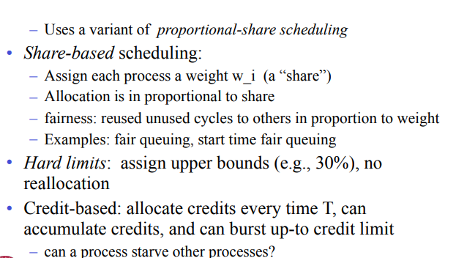
Proportional Share Scheduling

Slide 19
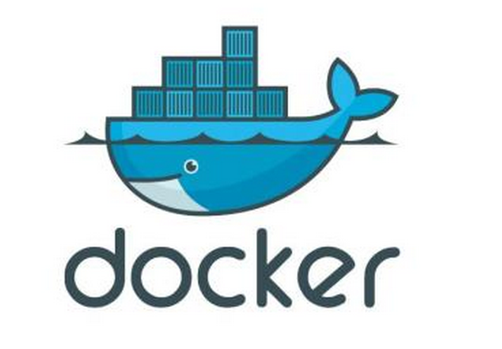
Docker
Introduction and Demo

Slide 20
Agenda
01
What is Docker
02
Why use Docker
03
How to setup Docker in Linux
04
Commands & Refrences

Slide 21
01
What is Docker

Slide 22
What is Docker - Overview
Docker is the company driving the container movement and the only container platform provider to address every application across the hybrid cloud. Today’s businesses are under pressure to digitally transform but are constrained by existing applications and infrastructure while rationalizing an increasingly diverse portfolio of clouds, datacenters and application architectures. Docker enables true independence between applications and infrastructure and developers and IT ops to unlock their potential and creates a model for better collaboration and innovation.
FREEDOM OF CHOICE
AGILE OPERATION
INTEGRATED SECURITY

Slide 23
Docker history
2013-03: Releases as Open Source
2013-09: Red Hat collaboration (Fedora, RHEL, OpenShift)
2014-03: 34th most starred GitHub project
2014-05: JAX Innovation Award (most innovative open technology)

Slide 24
What is Docker?
Docker is a software platform that allows you to build, test, and deploy applications quickly, packaging software into standardized units called containers.
Open Source engine to commoditize LXC
using copy-on-write for quick provisioning
allowing to create and share images
standard format for containers
standard, reproducible way to easily build trusted images (Dockerfile, Stackbrew...)

Slide 25
What is Docker – Basic Concepts
LXC
LXC(Linux Containers) is an operating-system-level virtualization method for running multiple isolated Linux systems(containers) on a control host using a single Linux kernel. Wikipedia
CGroups & Namespaces
The Linux kernel provides the cgroups functionality that allows limitation and prioritization of resources (CPU, memory, block I/O, network, etc.) without the need for starting any virtual machines, and also namespace isolation functionality that allows complete isolation of an applications' view of the operating environment, including process trees,networking, user IDs and mounted file systems
AUFS
AUFS (short for advanced multi-layered unification filesystem) implements a union mount for Linux file systems

Slide 26
What is Docker – Basic Concepts
Linux Boot
Start
Readonly /Readwrite
Kerenl lock Rootfs-readonly
Rootfs(Root File System - /dev,/bin,/etc)
Bootfs(Boot File System-Bootloader,kernel)

Slide 27
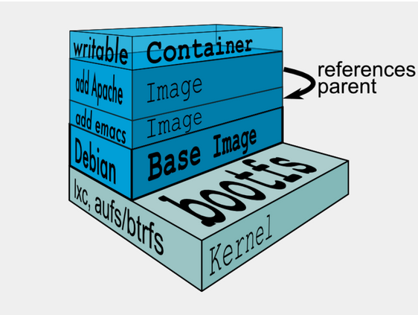
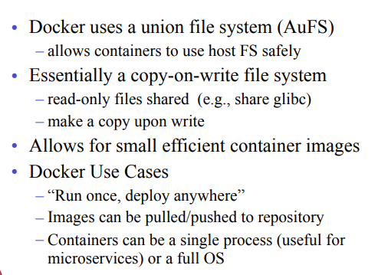
Docker Images and Uses

Slide 28

What is Docker - Contains
Docker Host
Docker Daemon, Image, Container
Docker Client
Docker Registry
Docker Machine

Slide 29

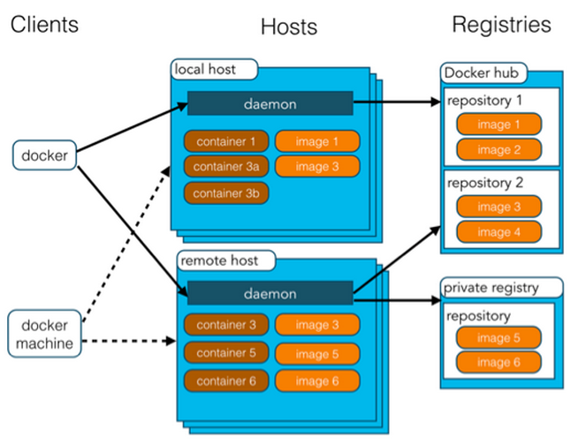
What is Docker - Contains

Slide 30
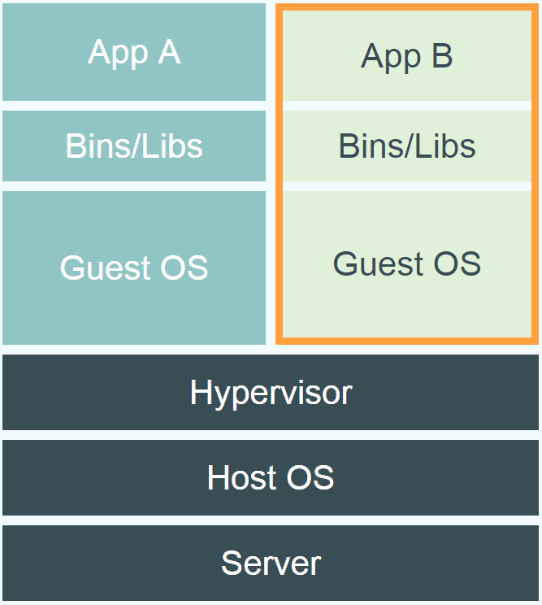
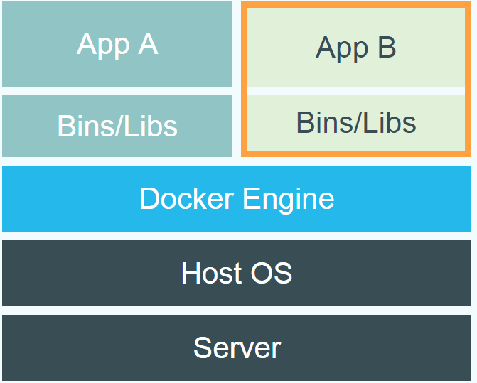
Comparison between LXC/docker and VM

Slide 31
02
Why use Docker

Slide 32
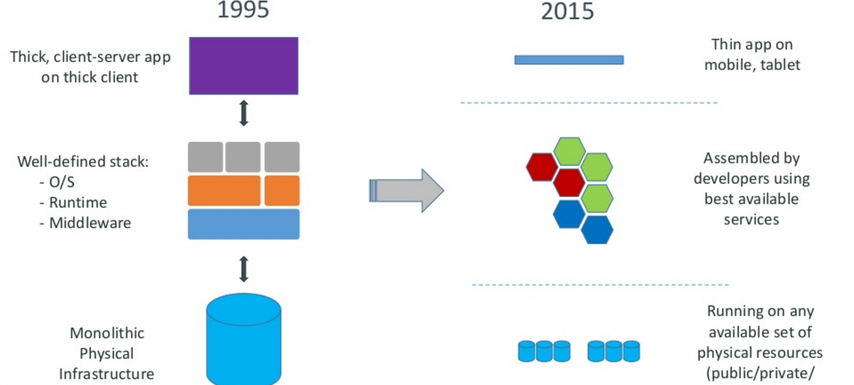
Motivation

Slide 33
Docker
Minimal learning curve
Rebuilds are easy
Caching system makes rebuilds faster
Single file to define the whole environment!

Slide 34
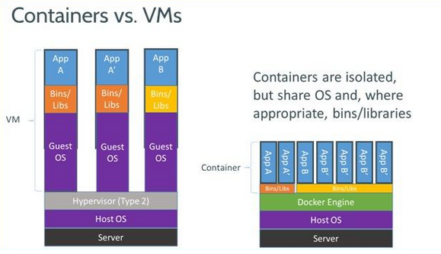
Why use Docker – Compare with VM
Hardware-level-virtualization
OS-level-virtualization
1
2
Hyper-V (OS atlease 5G)
VMWare, AWS EC2
Docker

Slide 35
Why use Docker – Advantages
Simplifying Configuration
App Isolation
Docker
Code pipeline management
Server Consolidation
Developer Productivity
Debugging Capabilities

Slide 36
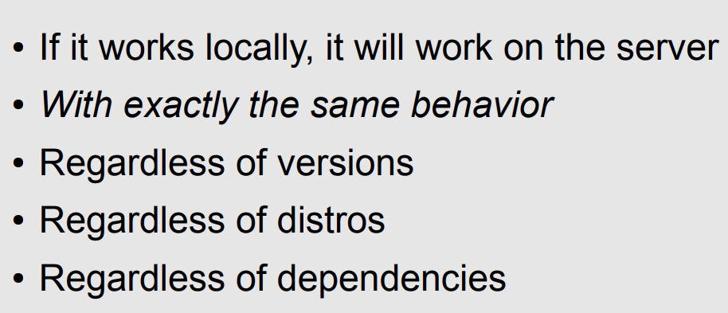
Deploy Reliability and Consistently

Slide 37
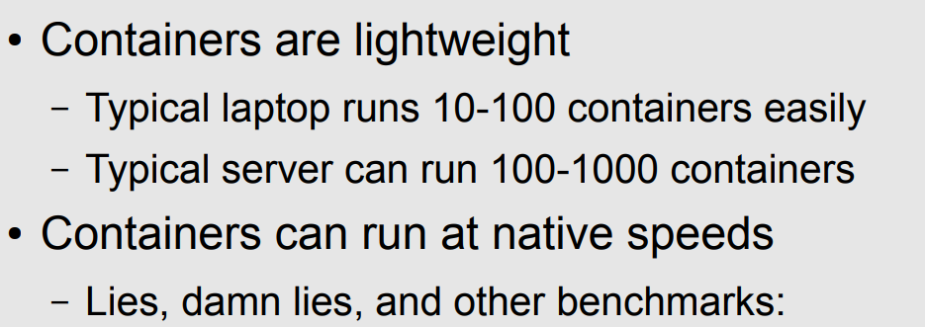
Deploy Efficiently

Slide 38
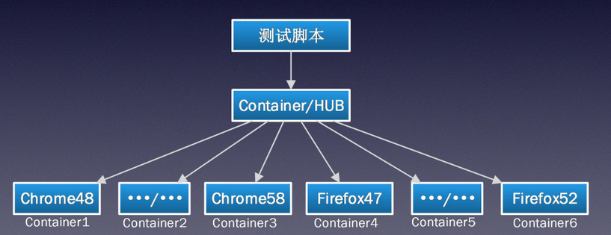
Why use Docker – Docker in Test
Test scripts

Slide 39
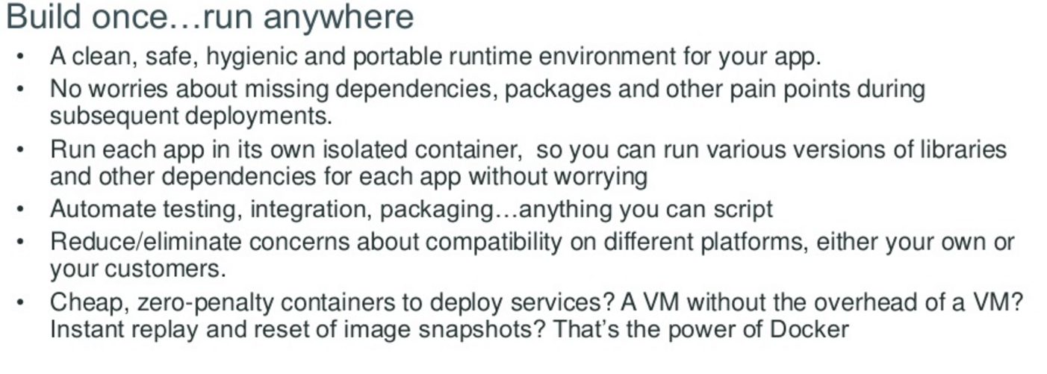
Docker container—developer viewpoint

Slide 40
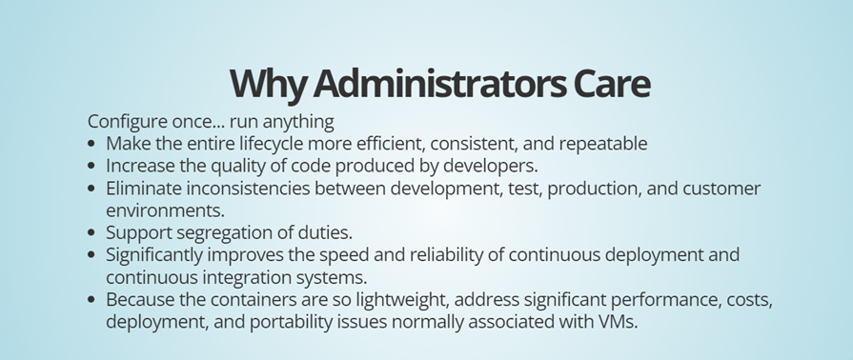
Administrative Benefits

Slide 41
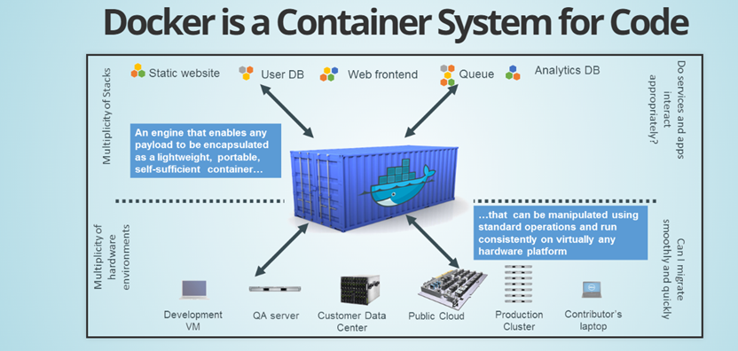
Docker Code Deployment

Slide 42
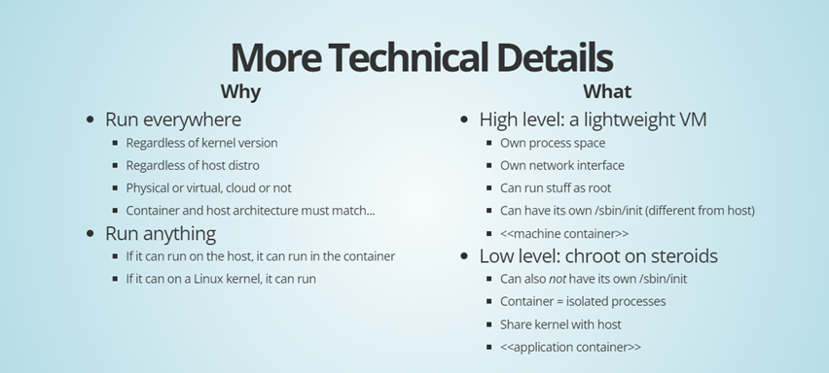
Docker Technical Details

Slide 43
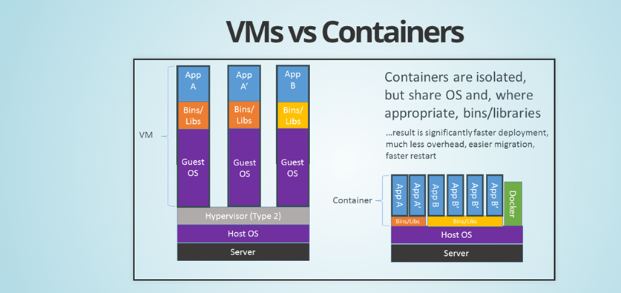
Comparison between VMS vs Containers

Slide 44
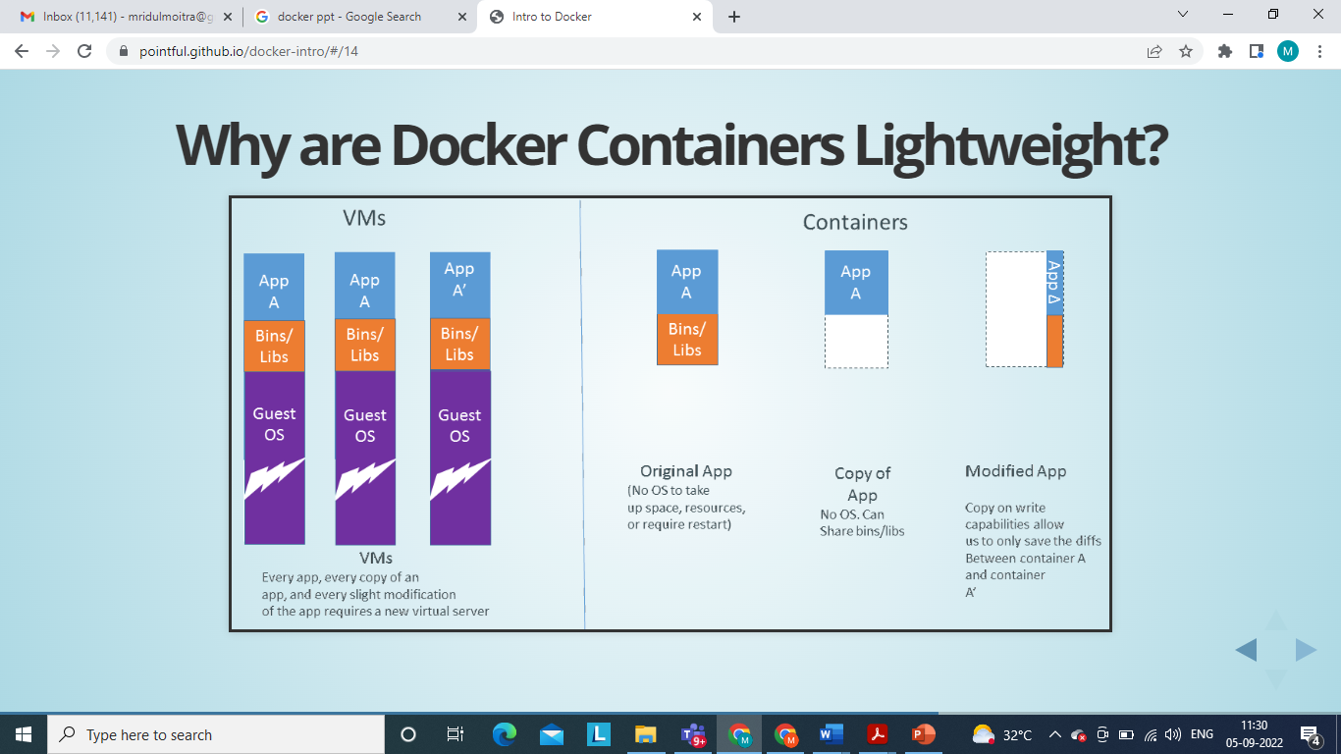

Slide 45
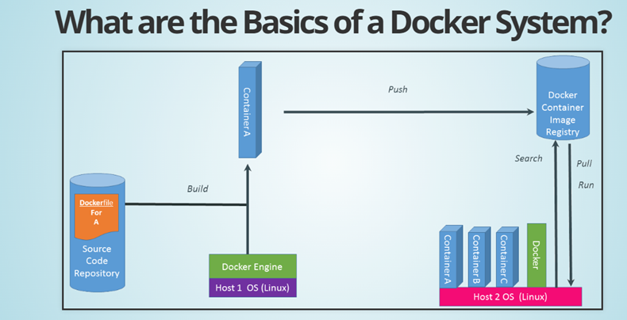
Docker Deployment

Slide 46
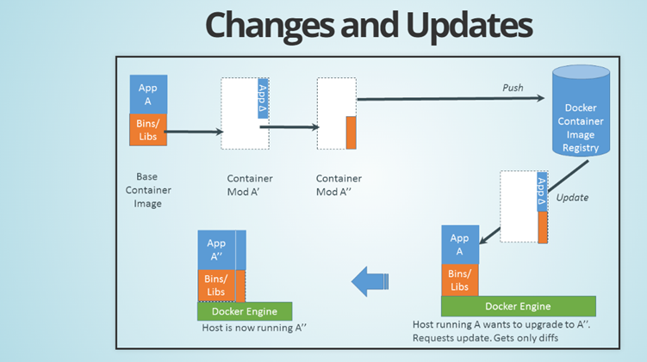
Docker Changes

Slide 47
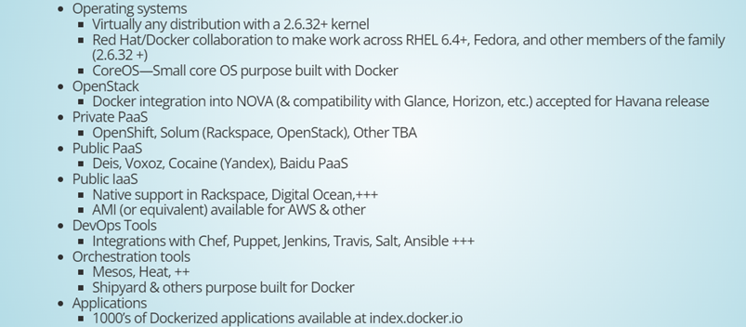
Ecosystem Supports

Slide 48
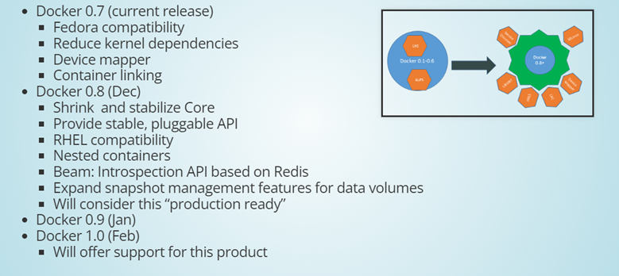
Docker Futures

Slide 49
Dockerfile
It is possible to build your own images reading instructions from a Dockerfile
FROM centos:7
RUN yum install -y python-devel python-virtualenv
RUN virtualenv /opt/indico/venv
RUN pip install indico
COPY entrypoint.sh /opt/indico/entrypoint.sh
EXPOSE 8000
ENTRYPOINT /opt/indico/entrypoint.sh

Slide 50
docker-compose
Allows to run multi-container Docker applications reading instructions from a docker-compose.yml file
version: "2"
services:
my-application:
build: ./
ports:
- "8000:8000"
environment:
- CONFIG_FILE
db:
image: postgres
redis:
image: redis
command: redis-server --save "" --appendonly no
ports:
- "6379"

Slide 51
Docker use cases
Development Environment
Environments for Integration Tests
Quick evaluation of software
Microservices
Multi-Tenancy
Unified execution environment (dev → test → prod (local, VM, cloud, ...)

Slide 52
03
How to setup Docker in Linux

Slide 53
How to setup Docker in Linux – Oracle linux 7.x
1. Touch file /etc/yum.repos.d/docker.repo name=Docker Repository baseurl=https://yum.dockerproject.org/repo/main/oraclelinux/7 enabled=1 gpgcheck=1 gpgkey=https://yum.dockerproject.org/gpg 2. Yum install -y docker-engine 3. Configure Firewall： systemctl disable firewalld yum install -y iptables-services systemctl enable iptables systemctl start iptables 4. Automatic start: systemctl enable docker.service 5. Manually start: systemctl start docker.service 6. Check status: systemctl status docker.service

Slide 54
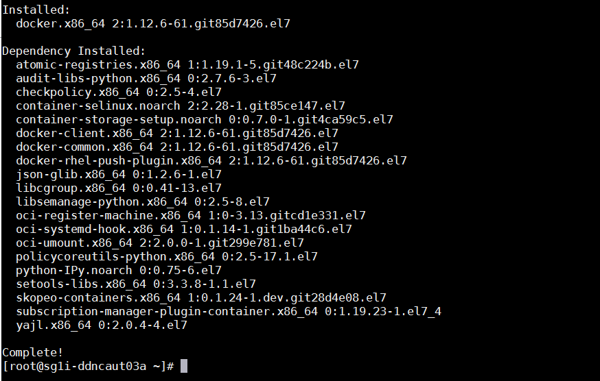
How to setup Docker in Linux – RHEL 7.4 build

Slide 55
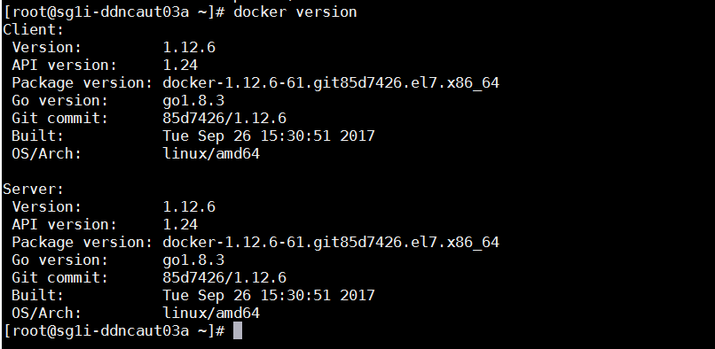
How to setup Docker in Linux – RHEL 7.4 build

Slide 56
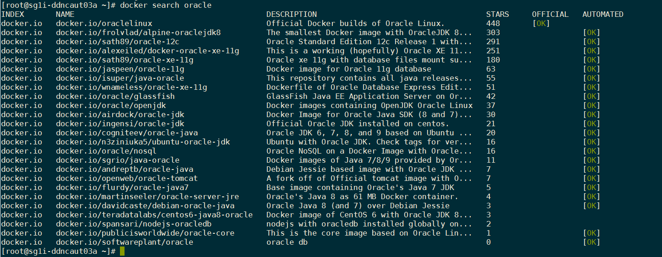
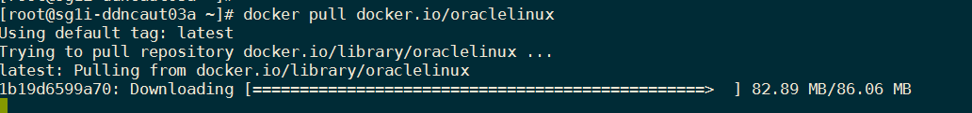
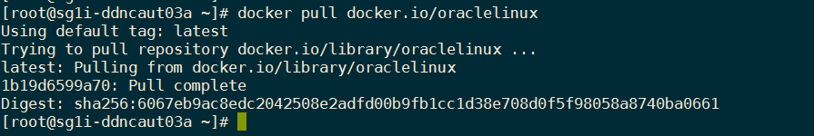
How to setup Docker in Linux – RHEL 7.4 build

Slide 57
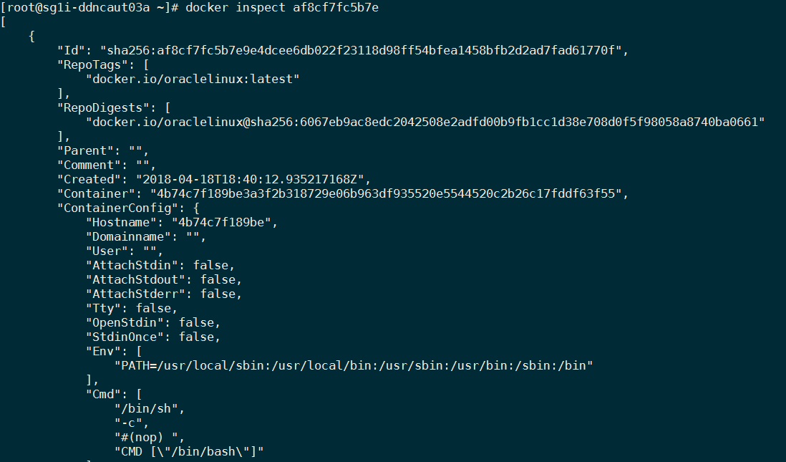
How to setup Docker in Linux – RHEL 7.4 build

Slide 58
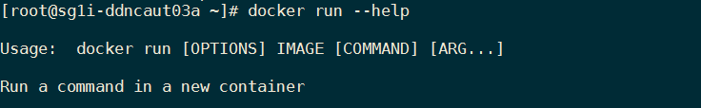
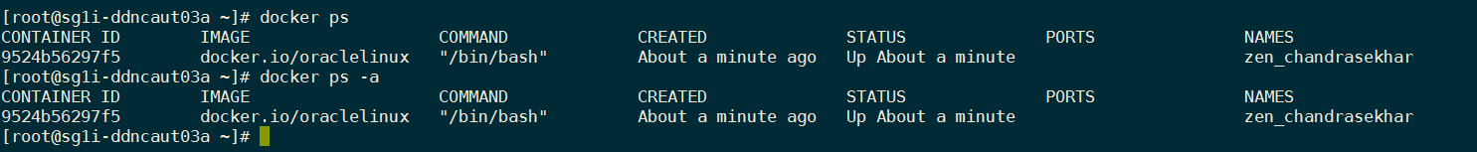
How to setup Docker in Linux – RHEL 7.4 build

Slide 59
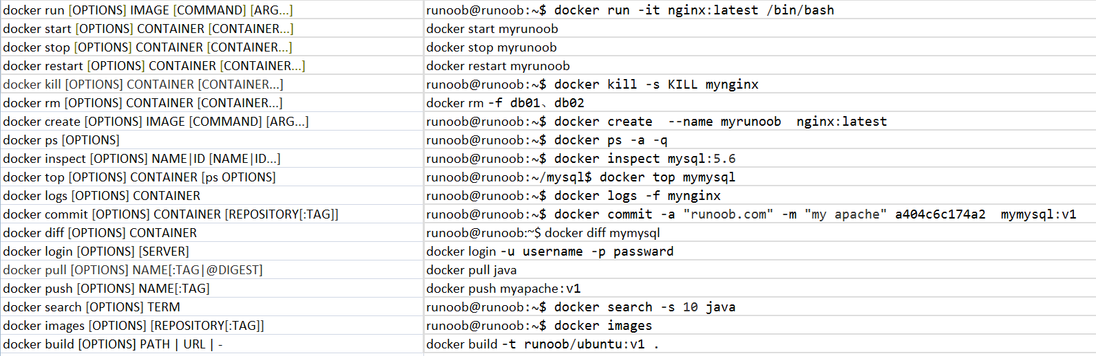
Commands & Reference – Docker Commands

Slide 60
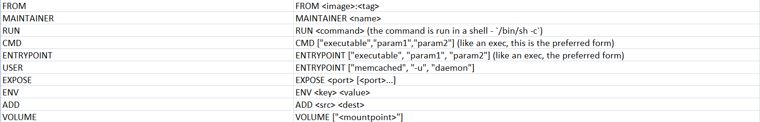
Commands & Reference – Dockerfile Commands

Slide 61
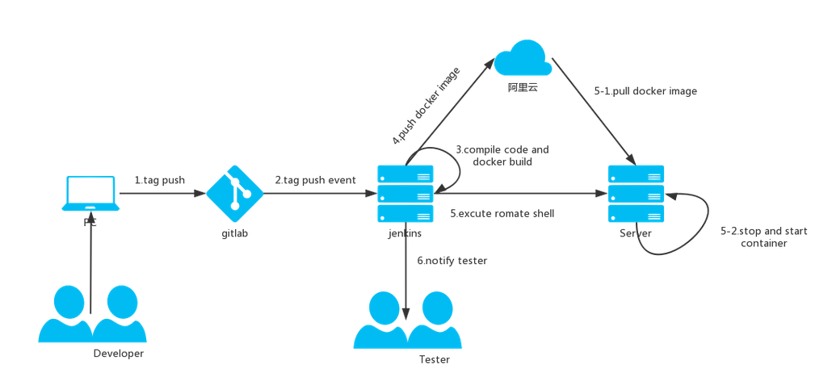

Why use Docker – Docker in Devopes
AWS

Slide 62
Commands & References – References
http://www.docker.com
https://docs.docker.com/linux/
https://docs.docker.com/engine/userguide/
https://www.docker.com/open-source
https://hub.docker.com/
https://www.docker-cn.com/
https://thehub.thomsonreuters.com/docs/DOC-2572951

Slide 63
Comparison between LXC/docker and VM

Slide 64
Docker Engine
the Docker engine runs in the background
manages containers, images, and builds
HTTP API (over UNIX or TCP socket)
embedded CLI talking to the API

Slide 65
Building docker image
With run/commit commands
1) docker run ubuntu bash
2) apt-get install this and that
3) docker commit <containerid> <imagename>
4) docker run <imagename> bash
5) git clone git://.../mycode
6) pip install -r requirements.txt
7) docker commit <containerid> <imagename>
8) repeat steps 4-7 as necessary
9) docker tag <imagename> <user/image>
10) docker push <user/image>

Slide 66
Docker
Base Image
ubuntu:latest
run
Container
cid1
base image
cmd → new state
New Image
iid1
commit
Container
cid1
run
Container
cid2
Container
cid3
Container
cid4

Slide 67
Authoring image with a dockerfile
A sample dockerfile
FROM ubuntu
RUN apt-get -y update
RUN apt-get install -y g++
RUN apt-get install -y erlang-dev erlang-manpages erlang-base-hipe ...
RUN apt-get install -y libmozjs185-dev libicu-dev libtool ...
RUN apt-get install -y make wget
RUN wget http://.../apache-couchdb-1.3.1.tar.gz | tar -C /tmp -zxf-
RUN cd /tmp/apache-couchdb-* && ./configure && make install
RUN printf "[httpd]\nport = 8101\nbind_address = 0.0.0.0" >
/usr/local/etc/couchdb/local.d/docker.ini
EXPOSE 8101
CMD ["/usr/local/bin/couchdb"]
Run the command to build:
docker build -t your_account/couchdb .

Slide 68
Docker Hub
Public repository of Docker images
https://hub.docker.com/
docker search [term]
Automated: Has been automatically built from Dockerfile
Source for build is available on GitHub

Slide 69
Dev-> test->production
code in local environment
(« dockerized » or not)
each push to the git repo triggers a hook
the hook tells a build server to clone the code and run
« docker build » (using the Dockerfile)
the containers are tested (nosetests, Jenkins...),
and if the tests pass, pushed to the registry
production servers pull the containers and run them
for network services, load balancers are updated

Slide 70
Docker has a repository like github
you can push and pull container images to/from the Docker registry
which is something like a “GitHub” for Docker container images.

Slide 71
Docker has a repository like github
you can push and pull container images to/from the Docker registry
which is something like a “GitHub” for Docker container images.

Slide 72
Multitenancy – Introduction
Multi-tenancy is an architecture in which a single instance of a software application serves multiple customers. Each customer is called a tenant. Tenants may be given the ability to customize some parts of the application, such as color of the user interface (UI) or business rules, but they cannot customize the application's code.
A software-as-a-service (SaaS) provider, for example, can run one instance of its application on one instance of a database and provide web access to multiple customers. In such a scenario, each tenant's data is isolated and remains invisible to other tenants.
Notes:
http://www.rightscale.com/blog/enterprise-cloud-strategies/four-steps-achieving-high-availability-cloud

Slide 73
Multitenancy – Introduction
Multi-tenancy is an architectural pattern
A single instance of the software is run on the service provider’s infrastructure
Multiple tenants access the same instance.
In contrast to the multi-user model, multi-tenancy requires customizing the single instance according to the multi-faceted requirements of many tenants.

Slide 74
Multitenancy – key aspects
A Multi-tenants application lets customers (tenants) share the same hardware resources, by offering them one shared application and database instance ,while allowing them to configure the application to fit there needs as if it runs on dedicated environment.
These definition focus on what we believe to be the key aspects of multi tenancy:
The ability of the application to share hardware resources.
The offering of a high degree of configurability of the software.
The architectural approach in which the tenants make use of a single application and database instance.

Slide 75
Multi-tenants Deployment Modes for Application Server
Fully isolated Application server Each tenant accesses an application server running on a dedicated servers.
Virtualized Application Server Each tenant accesses a dedicated application running on a separate virtual machine.
Shared Virtual Server Each tenant accesses a dedicated application server running on a shared virtual machine.
Shared Application Server The tenant shared the application server and access application resources through separate session or threads.
Application Server
Tenant A
Tenant B
Application server
Application server
Virtual machine
Tenant A
Virtual machine
Tenant B
Application server
Tenant A
Virtual machine
Tenant B
Tenant A
Session thread
Application Server
Tenant B
Session Thread

Slide 76
Multi-tenants Deployment Modes in Data Centers
Fully isolated data center The tenants do not share any data center resources
Virtualized servers The tenants share the same host but access different databases running on separate virtual machines
Shared Server The tenants share the same server (Hostname or IP) but access different databases
Shared Database The tenants share the same server and database (shared or different ports) but access different schema(tables)
Shared Schema The tenants share the same server, database and schema (tables). The irrespective data is segregated by key and rows.
Tenant A
Tenant B
Virtual
Machine
Database
Tenant A
Virtual
Machine
Database
Tenant B
Tenant A
Tenant B
Tenant A
Tenant B
Tenant A
Tenant B

Slide 77
Conceptual framework of Software as a Service
Presentation
Menu and Navigation
User Controls
Display and Rendering
Reporting
Security
Application Engine
Operation
Identity and federation
User Profile
Workflow
Monitoring and Altering
Authentication and Single Sign on
Notification and Subscription
Execution Handling
Backup and Restore
Authorization and Role-based Access Control
Metadata Execution Engine
Orchestration
Provisioning
Configuration and Customization
Entitlement
Metadata Services
Performance and Availability
Encryption
Messaging
Data Synchronization
Metering and Indicators
Regularity Controls
Infrastructure
Database
Storage
Computer
Networking and Communications
Notes:
Architectural Overview Of Cloud Computing
B.M. Rao, Senior Technical Director
National Informatics Centre,
Hyderaad

Slide 78
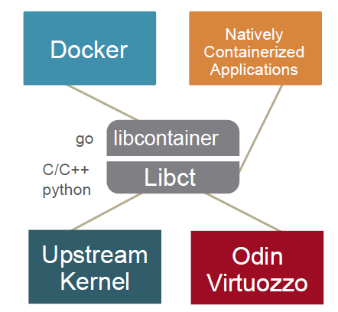
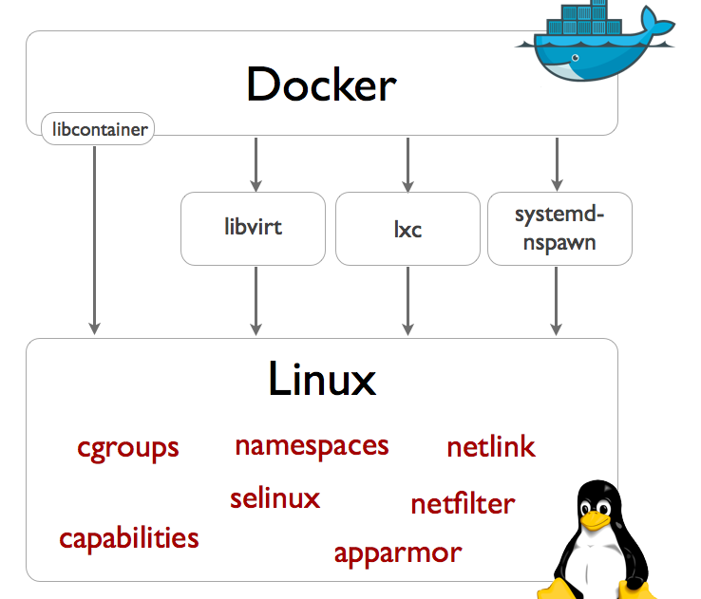
Docker needs containers

